Slide 1
On-the-Job Training: Organized by SENSWAT, Engineering Faculty, Kasetsart University
Date: 16 - 17 January 2025
Project: 30-Year Historical Gridded Rainfall by the Corrective Remote Sensing Product Method in Nam Theun 1 Hydropower Project Watershed
GIS Training
Fundamental to GIS
Map making
Preparing Gridded Gauged Rainfall (GGR) Using IDS
Data preparation (add points from excel file)
Creating GGR using Inverse Distance Square (IDS)
Zonal Rainfall Raster

Slide 2
Geographic Information System (GIS)
GIS is a technology that is used to create, manage, analyze, and map all types of data.
Data management
GIS is a foundational system of record. You can store and integrate information from business systems and authoritative sources, magnifying data’s usefulness.
Mapping and visualization
From digital maps and dashboards to satellite imagery, 3D, and real time-GIS brings data to life, helping us understand problems and solve them.
Spatial analysis
Most data has a location component—everything happens somewhere. With spatial analysis tools, we find hidden relationships and generate new insights from data.
Communication
Maps and dashboards communicate complex ideas quickly. Science and data build common understanding, supporting collaboration and problem-solving.
Ref: https://www.esri.com/en-us/what-is-gis/overview

Slide 3
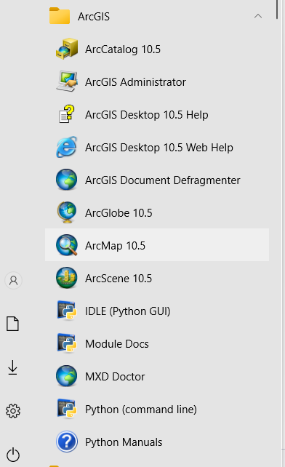
Fundamental to GIS
Creating a New Shapefile
1. Open GIS Software
Launch GIS software such as ArcGIS
ArcMap 10.5

Slide 4
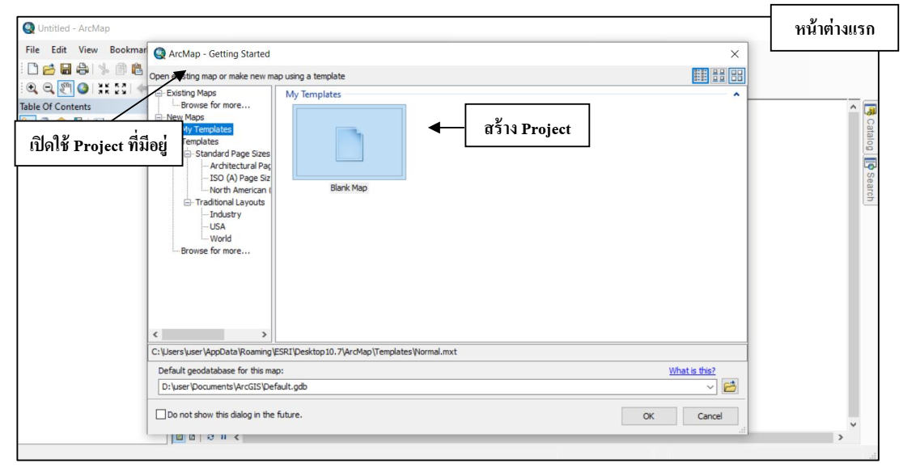
Fundamental to GIS
2. Navigate to Layer Creation
Go to the menu bar and select Layer > Create Layer > New Shapefile Layer.
First Window
Create Project
Open Existing Projects

Slide 5
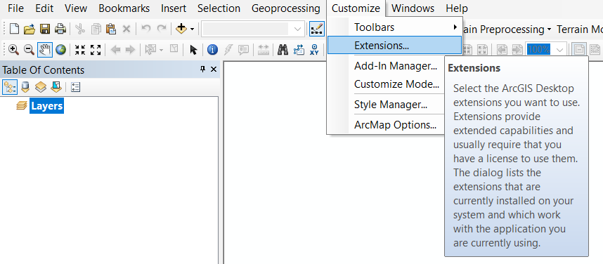
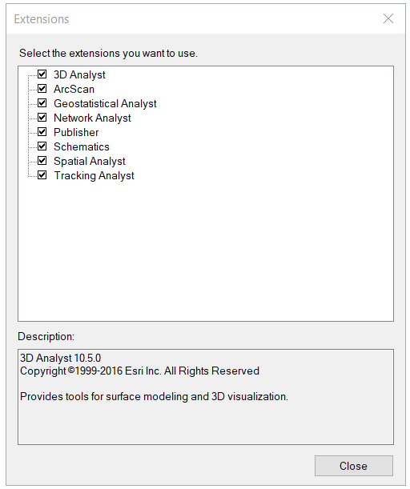
Fundamental to GIS
Remark: first time after installing ArcGIS

Slide 6
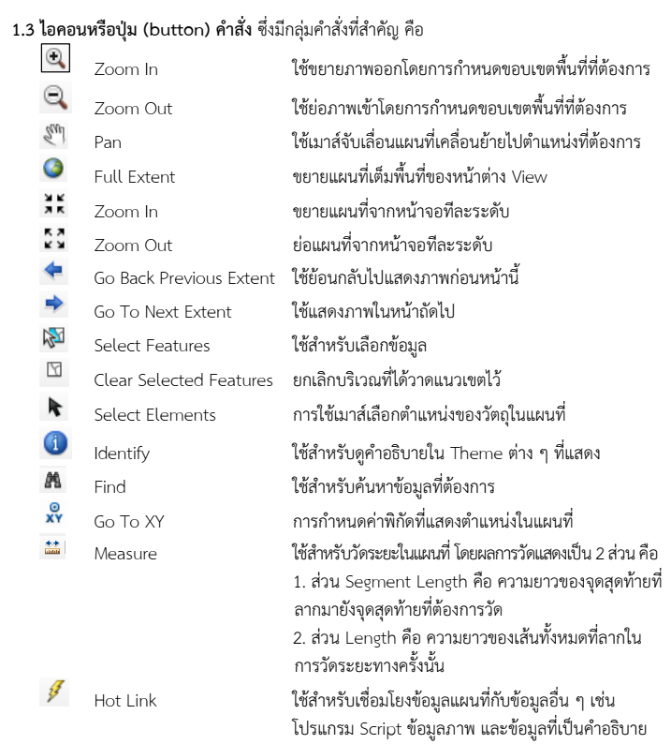
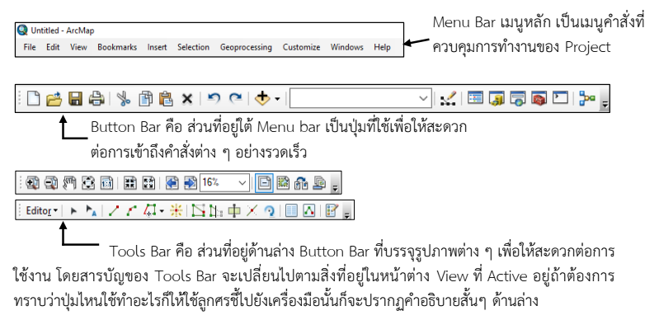
Fundamental to GIS
Icon or Command Button , Which has a group of important commands:
Menu Bar is the main menu that controls the operation of the project.
Zoom in the map by defining the desired area.
Zoom out the map by defining the desired area.
Use the mouse to move the map to the desired location.
Zoom in the map to fill the entire view window.
Button Bar is the section below Menu Bar, It is a button that provides quick access to various commands.
Zoom in the map from the screen one level at a time.
Zoom out the map from the screen one level at a time.
Use to return to the previous image.
Use to display the next image.
Use to select features data.
Tools Bar is the section below Button Bar that contains various images for ease of use. The contents of the Tools Bar change depending on what is in the active View window. To know what a button does, point to the tool with the arrow and a short description will appear below.
Cancel the area where the boundary has been drawn.
Use the mouse to select location of object in the map
Use to view descriptions of themes displayed.
Use to find the desired information.
Setting the coordinates that show the location on the map.
Use to measure distances on the map. The measurement is displayed in 2 parts:
Segment Length is the length of the last point drawn to the last point to be measured.
Length is the length of entire lines drawn in that distance measurement.
Use to link map data with other data such as script, image data and descriptive data.

Slide 7
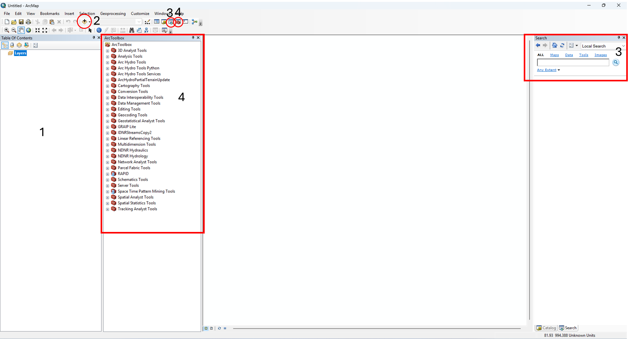
Fundamental to GIS
Table of content
Add Data
Search
ArcToolbox

Slide 8
Map making
1. Add data
SHP_Nam_Theun.shp = Shape Nam Theun
SHP_Nam_Theun_Sub.shp = Shape Sub-basin (NT1, NT2, NG, THB)
Rainfall_Station.shp = 34 rainfall stations
Main_river.shp = Main river
Hydro_Arc.shp = Tributary river

Slide 9
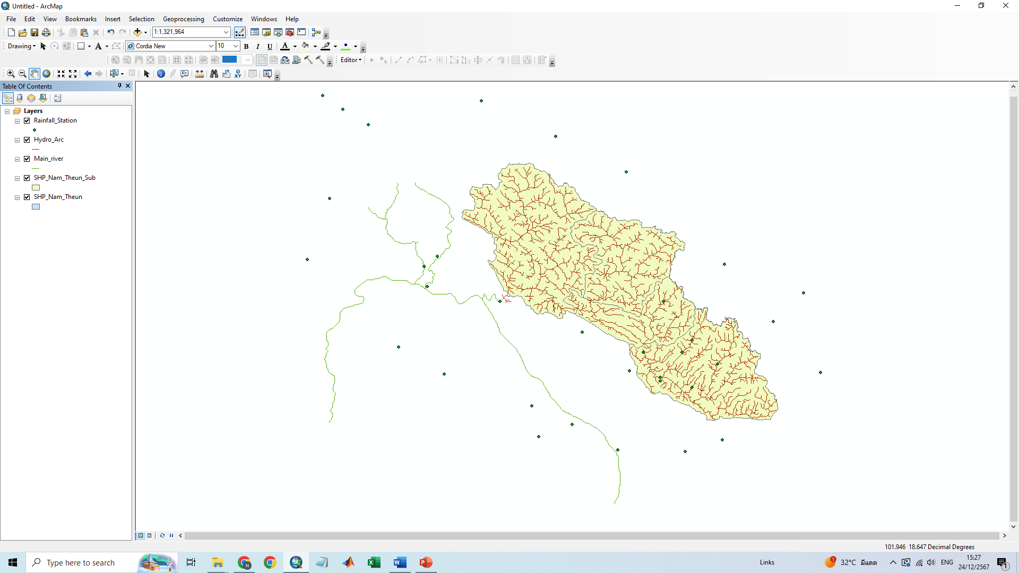
Map making
1. Add data

Slide 10
Map making
2. Change symbol

Slide 11
Map making
2. Change symbol: Categories
1
Right click
1
2
2
3

Slide 12
Map making
2. Change symbol: Categories
Double click

Slide 13
Map making
3. Label features
1
2
Right click
3
4
5

Slide 14
Map making
3. Label features
1
Right click
2

Slide 15
Map making
3. Label features
Double click

Slide 16
Map making
3. Label features
1
2
1
3
2

Slide 17
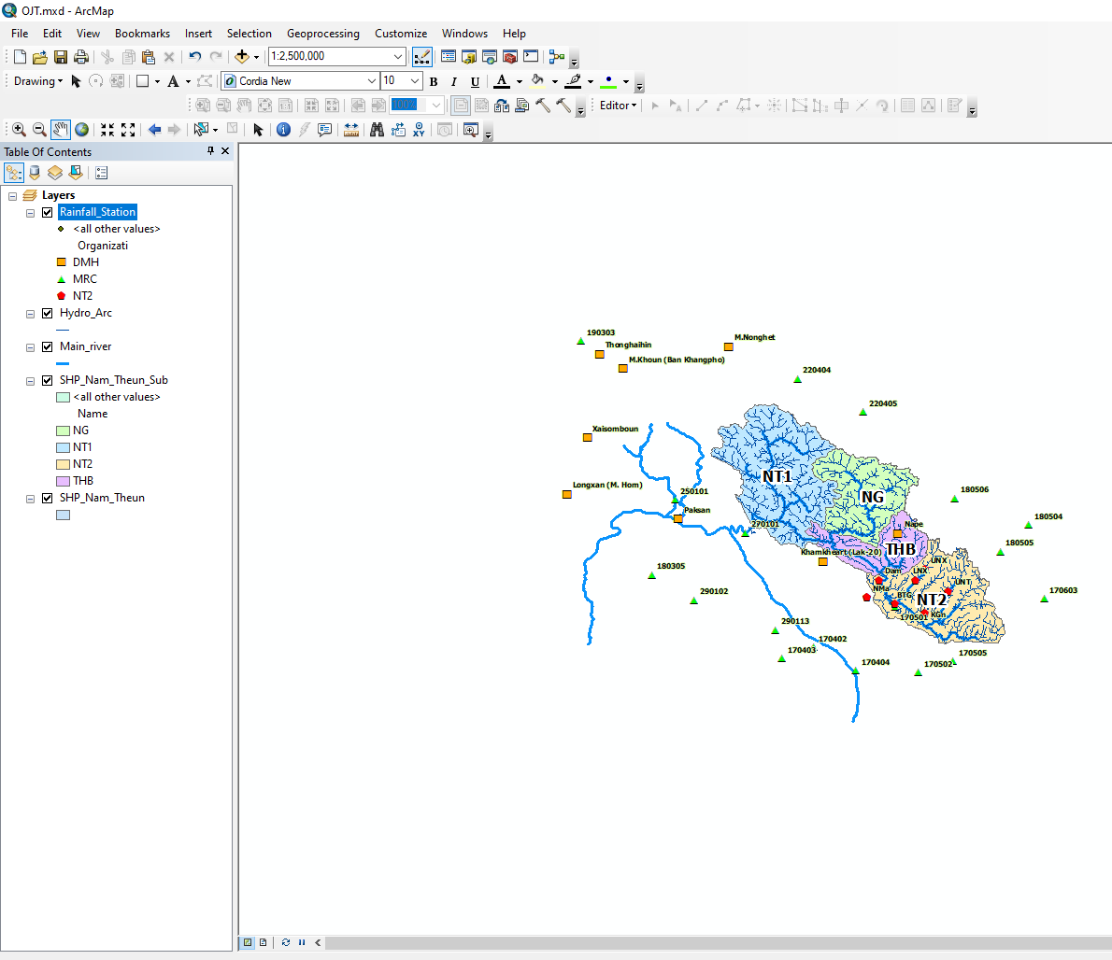
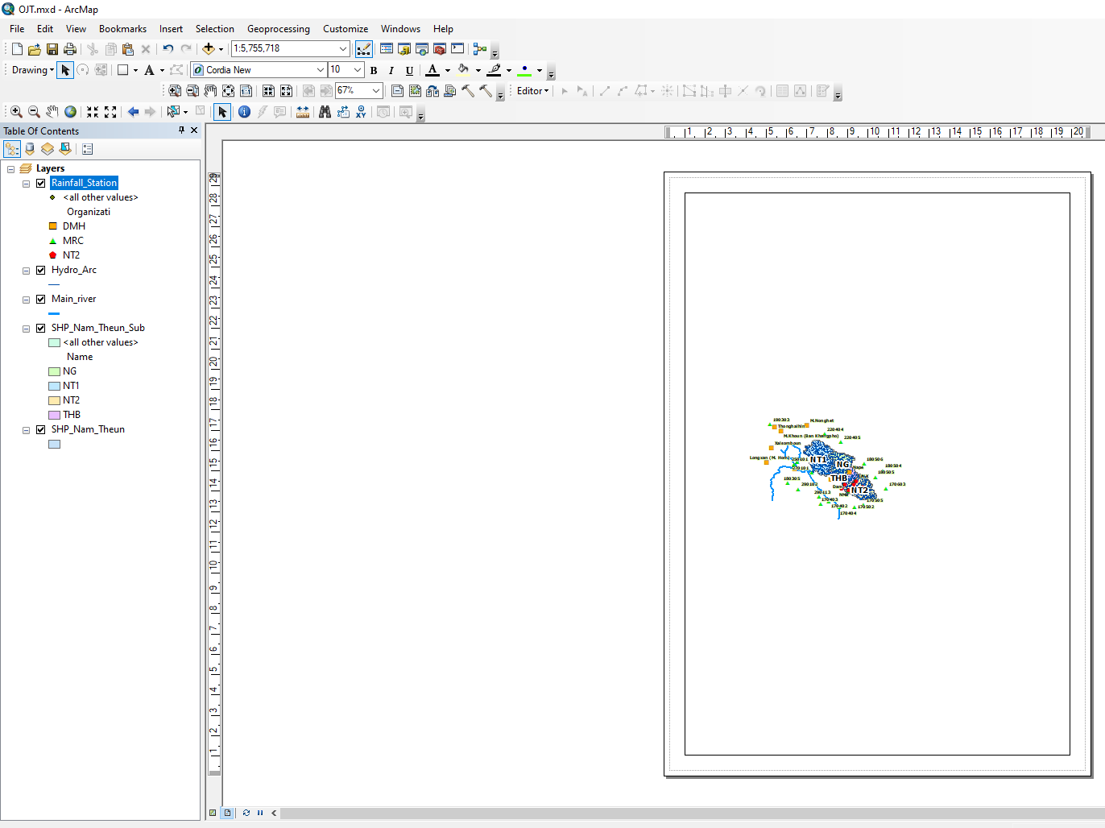
Map making
4. Data frame

Slide 18
Map making
4. Data frame

Slide 19
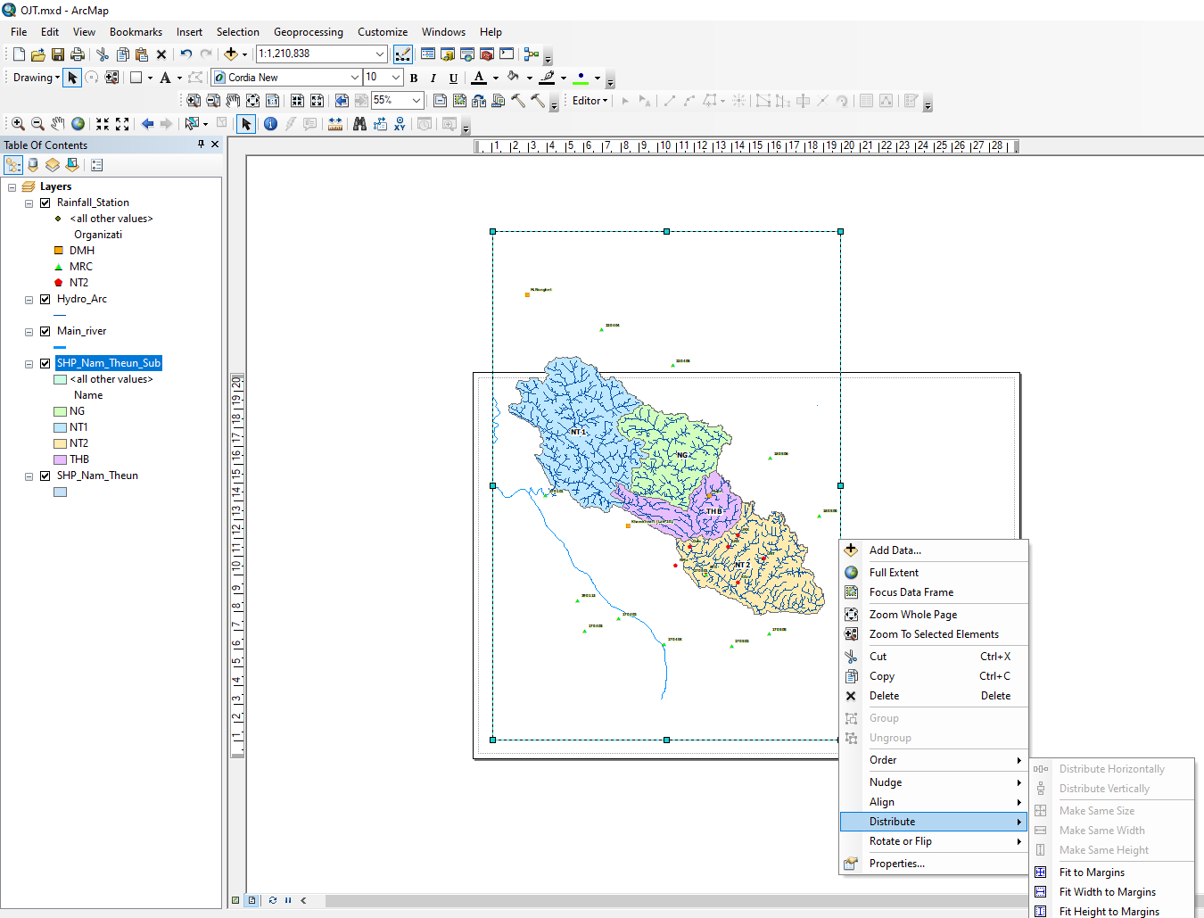
Map making
4. Data frame
1. Right click
2.
1. Right click
2.
3.

Slide 20
Map making
4. Data frame
Data Frame
Title
Text
Dynamic
Neatline
Legend
North Arrow
Scale Bar
Scale Text
Picture
Oblect

Slide 21
Map making
4. Data frame
1. Right click
2.

Slide 22
Map making
4. Data frame

Slide 23
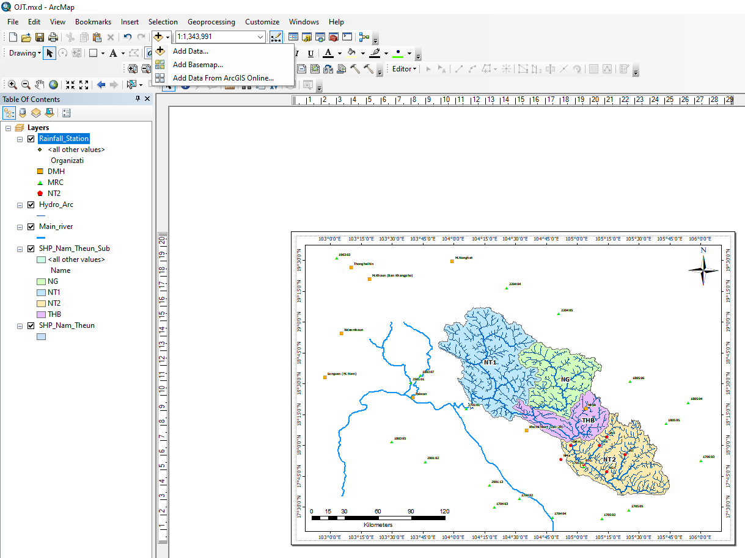
Map making
5. Add base map

Slide 24
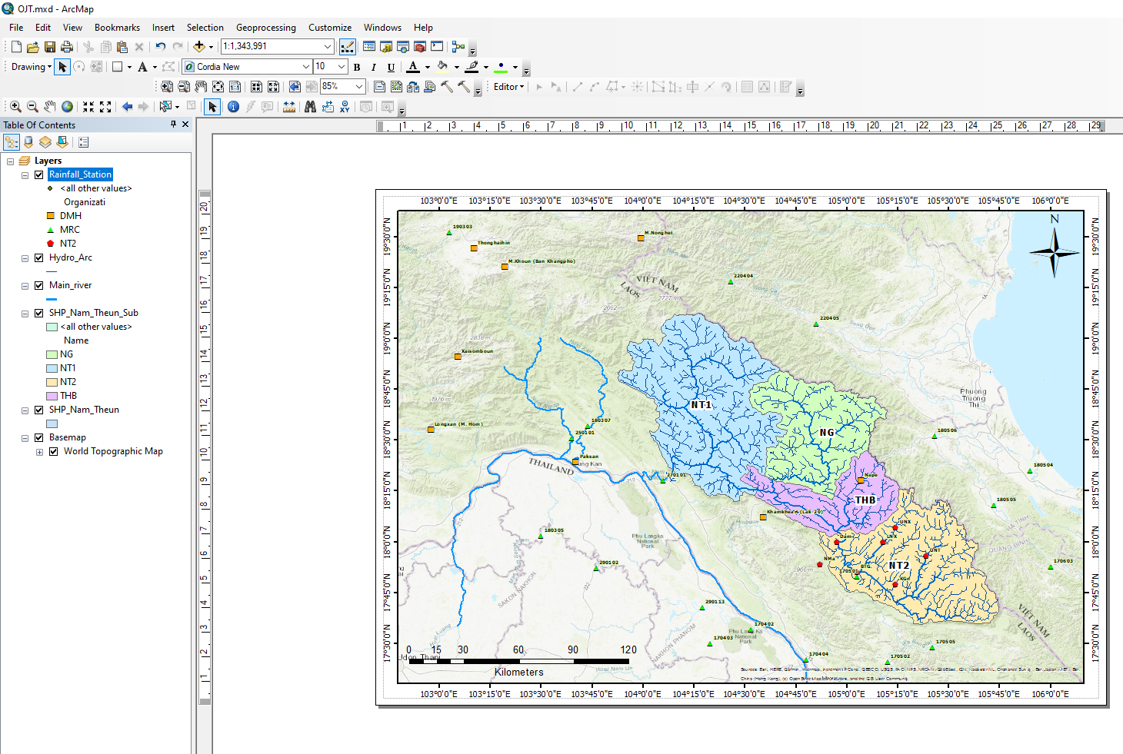
Map making
5. Add base map

Slide 25
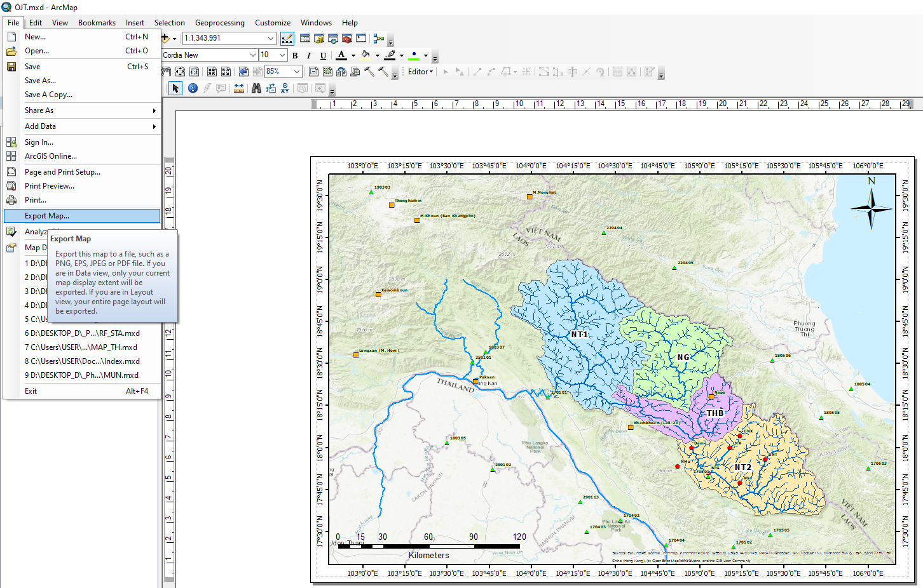
Map making
6. Export Data

Slide 26
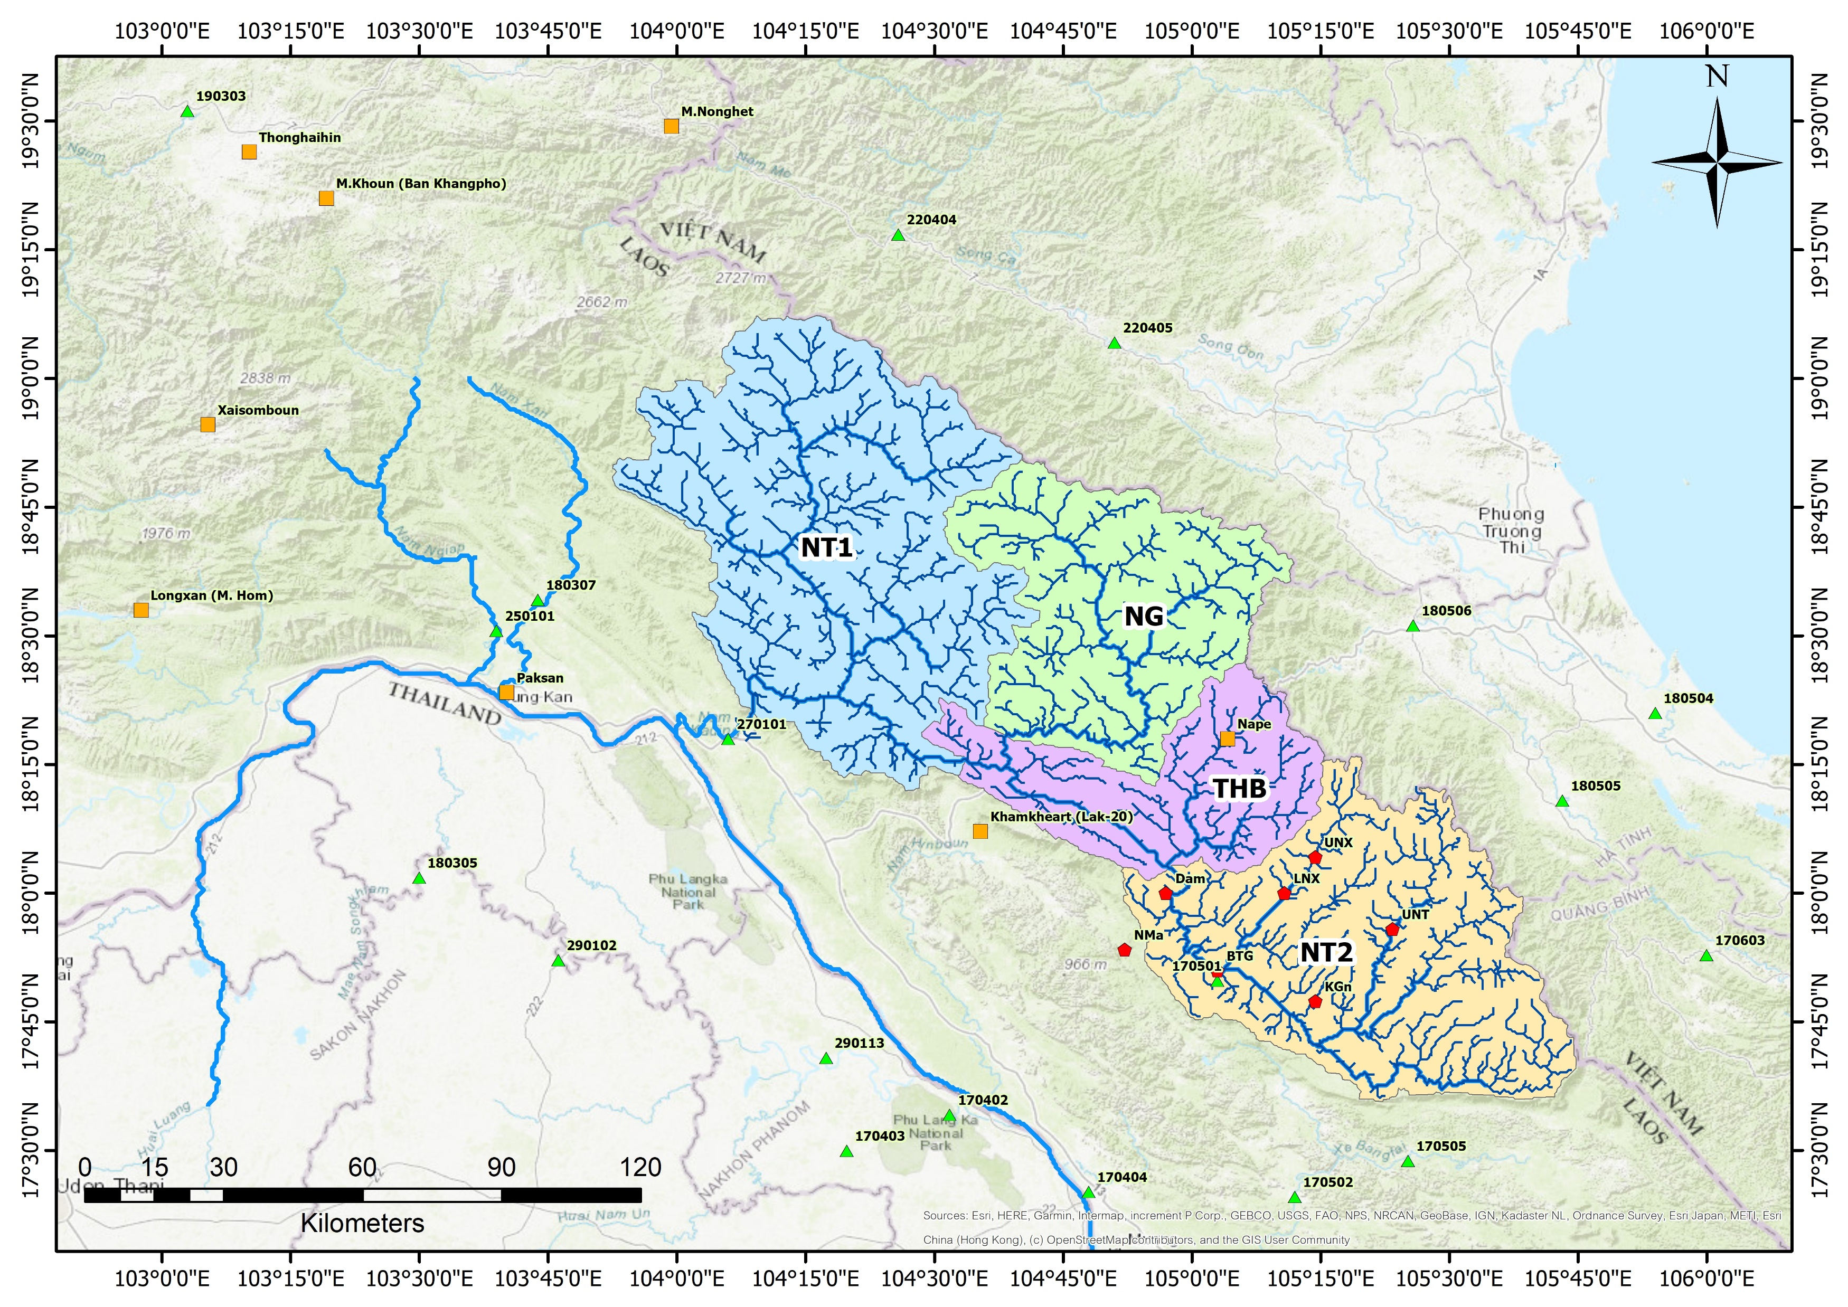
Map making
6. Export Data

Slide 27
Preparing Gridded Gauged Rainfall (GGR) Using IDS
Data preparation (add points from excel file)
Creating GGR using Inverse Distance Square (IDS)

Slide 28
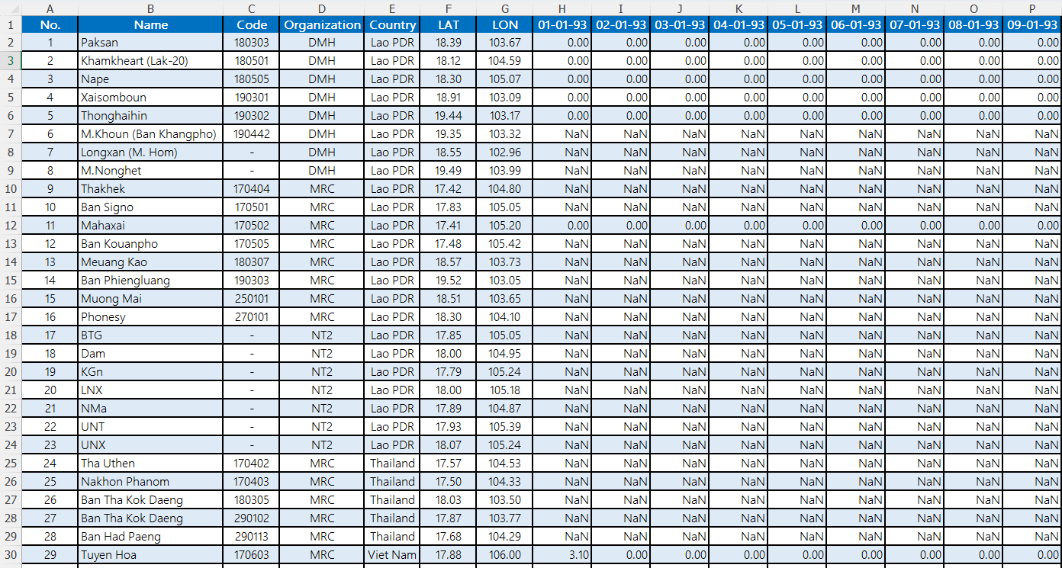
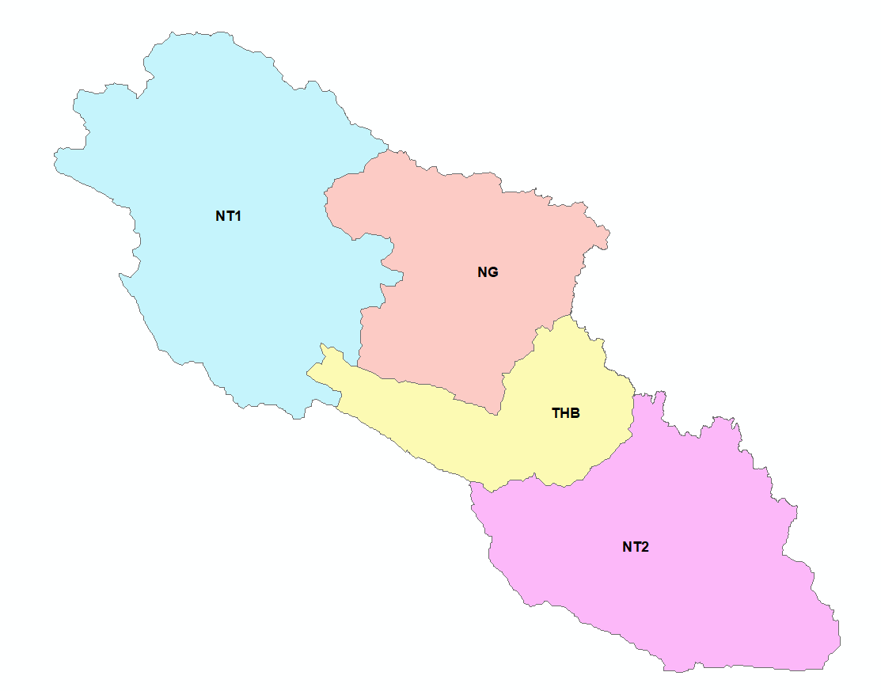
IDS
Preparing Gridded Gauged Rainfall (GGR) Using IDS
Step 1 : Data preparation
Excel file in “.xls” format
Station Name UTM/Decimal Degree Coordinates
Rainfall Data
Shapefile
Nam Theun Catchment

Slide 29
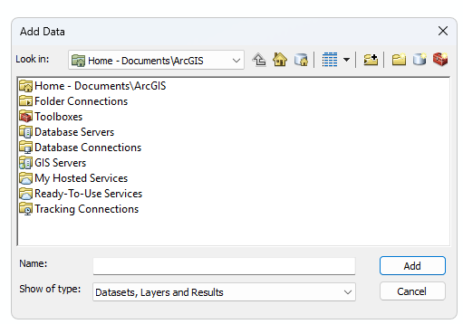
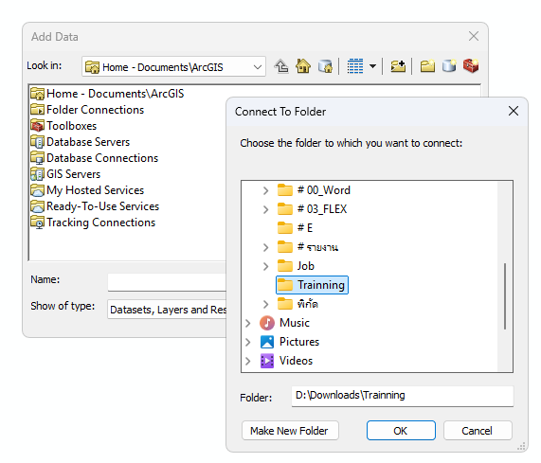
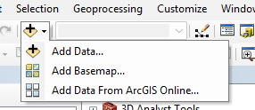
IDS
Preparing Gridded Gauged Rainfall (GGR) Using IDS
Set the Geometry Type
Point: For specific locations e.g., monitoring stations
Line: For linear features e.g., roads or rivers
Polygon: For area features e.g., land parcels
2
1
3
Go to the menu bar and (1) Add Data > (2) Connect to folder > (3)Selected folder > (4) Click OK.
4

Slide 30
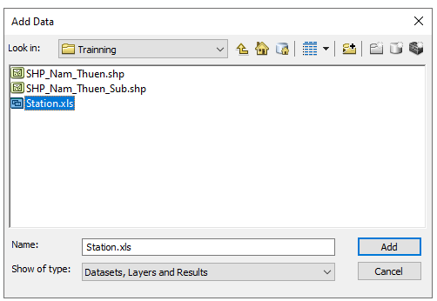
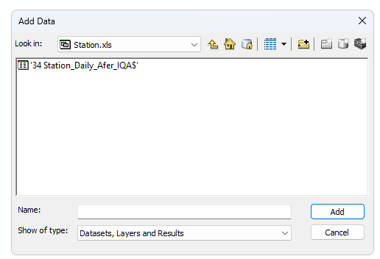
IDS
Preparing Gridded Gauged Rainfall (GGR) Using IDS
5
7
6
8
(5) Selected excel file (.xls) > (6) click Add > (7) Selected sheet > (8) click Add

Slide 31
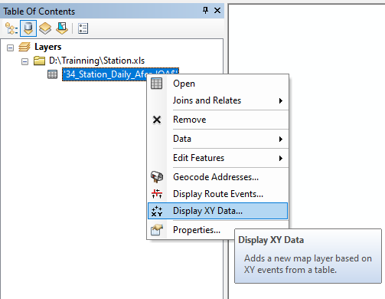
IDS
Preparing Gridded Gauged Rainfall (GGR) Using IDS
Define the Coordinate Reference System (CRS)
10
12
9
13
14
11

Slide 32
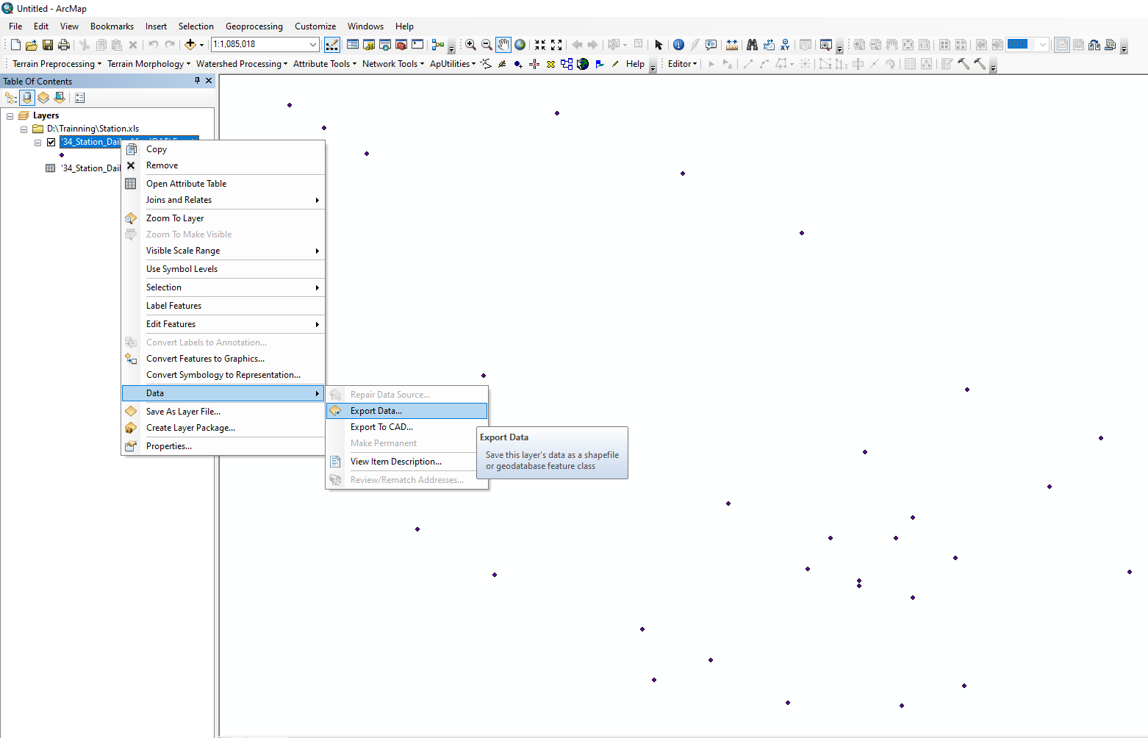
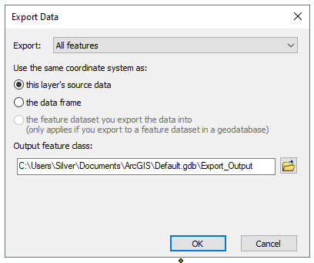
IDS
Preparing Gridded Gauged Rainfall (GGR) Using IDS
Save the Shapefile: Name your shapefile (.shp) and save it to a specified directory.
16
17
15

Slide 33
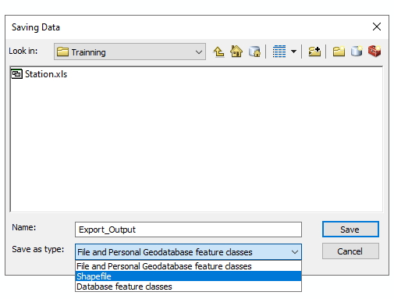
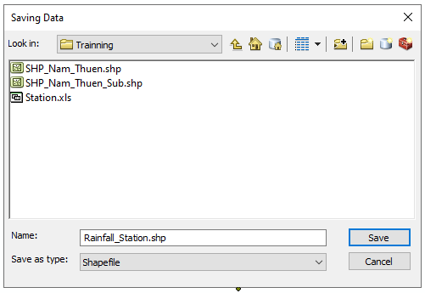
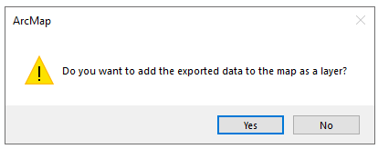
IDS
Preparing Gridded Gauged Rainfall (GGR) Using IDS
19
20
18

Slide 34
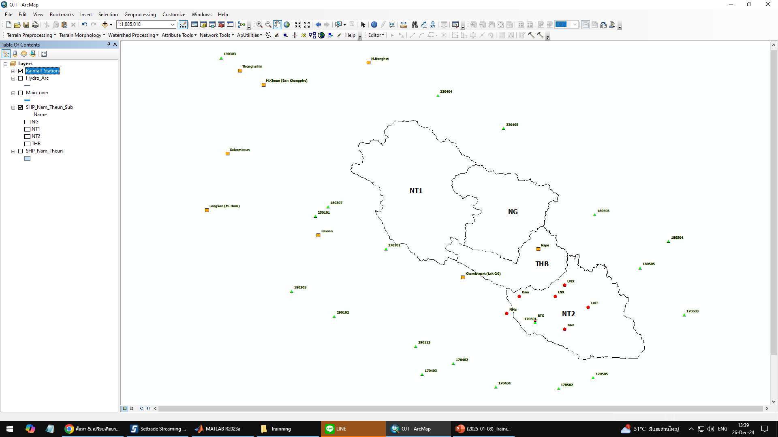
IDS
Preparing Gridded Gauged Rainfall (GGR) Using IDS
Result

Slide 35
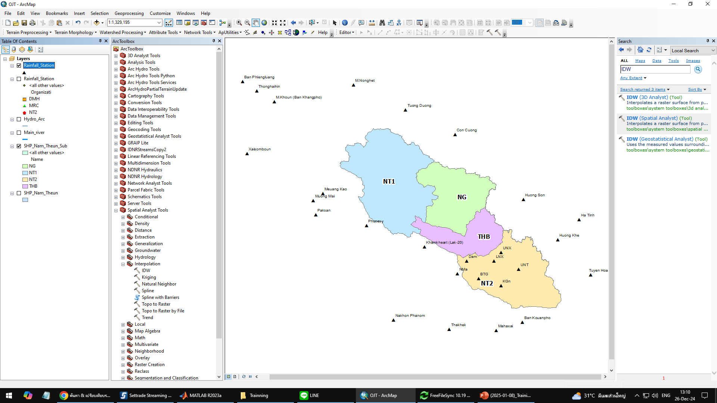
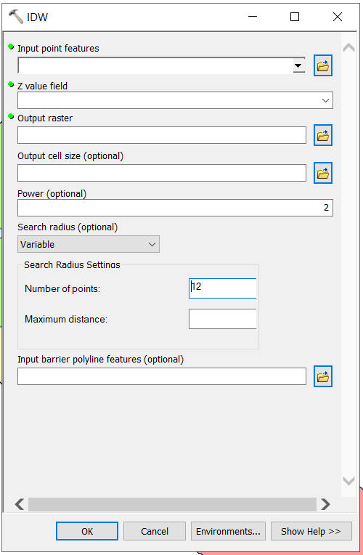
Preparing Gridded Gauged Rainfall (GGR) Using IDS
Step 2: Creating GGR using Inverse Distance Square (IDS)
Method 2
Method 1

Slide 36
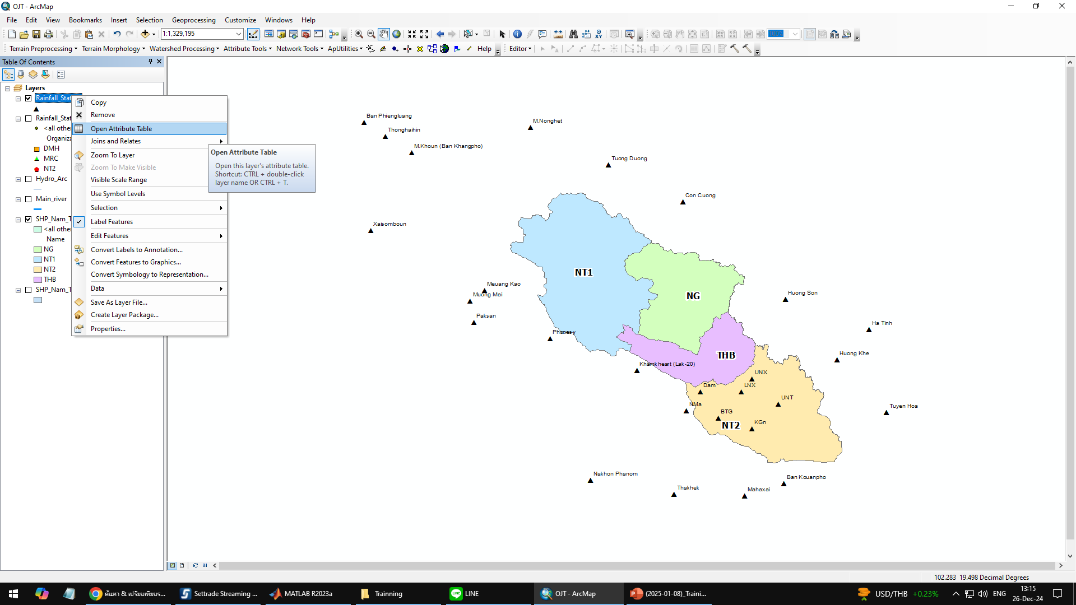
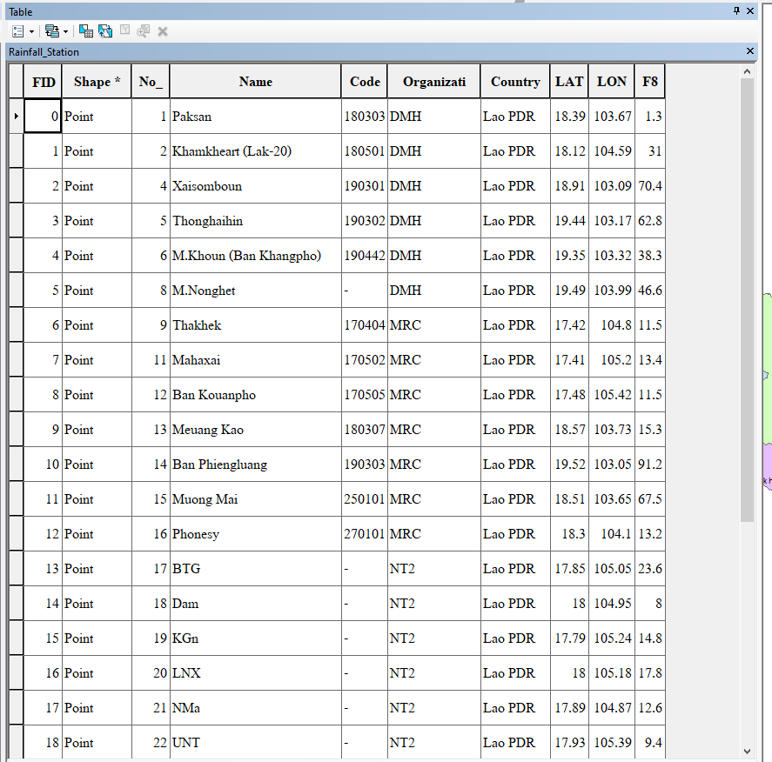
Preparing Gridded Gauged Rainfall (GGR) Using IDS
Step 2: Creating GGR using Inverse Distance Square (IDS)
How to open Attribute

Slide 37
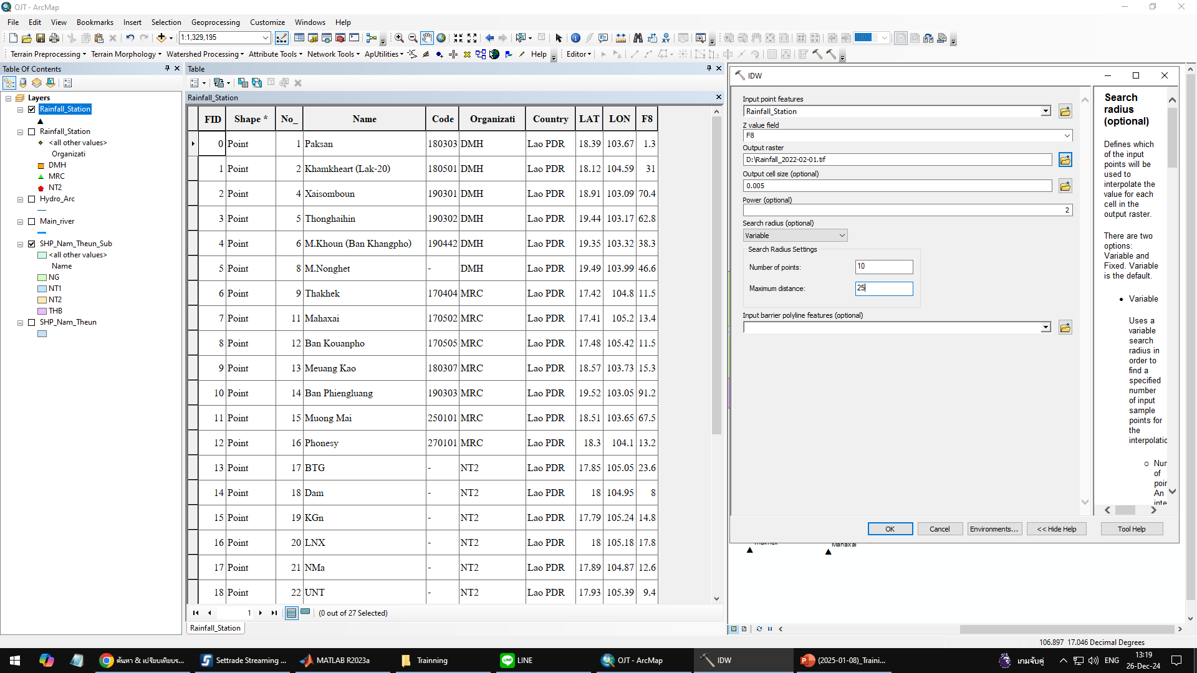
Preparing Gridded Gauged Rainfall (GGR) Using IDS
Step 2: Creating GGR using Inverse Distance Square (IDS)
1
Shapefile name
Shapefile header
Raster directory
Cell size
2

Slide 38
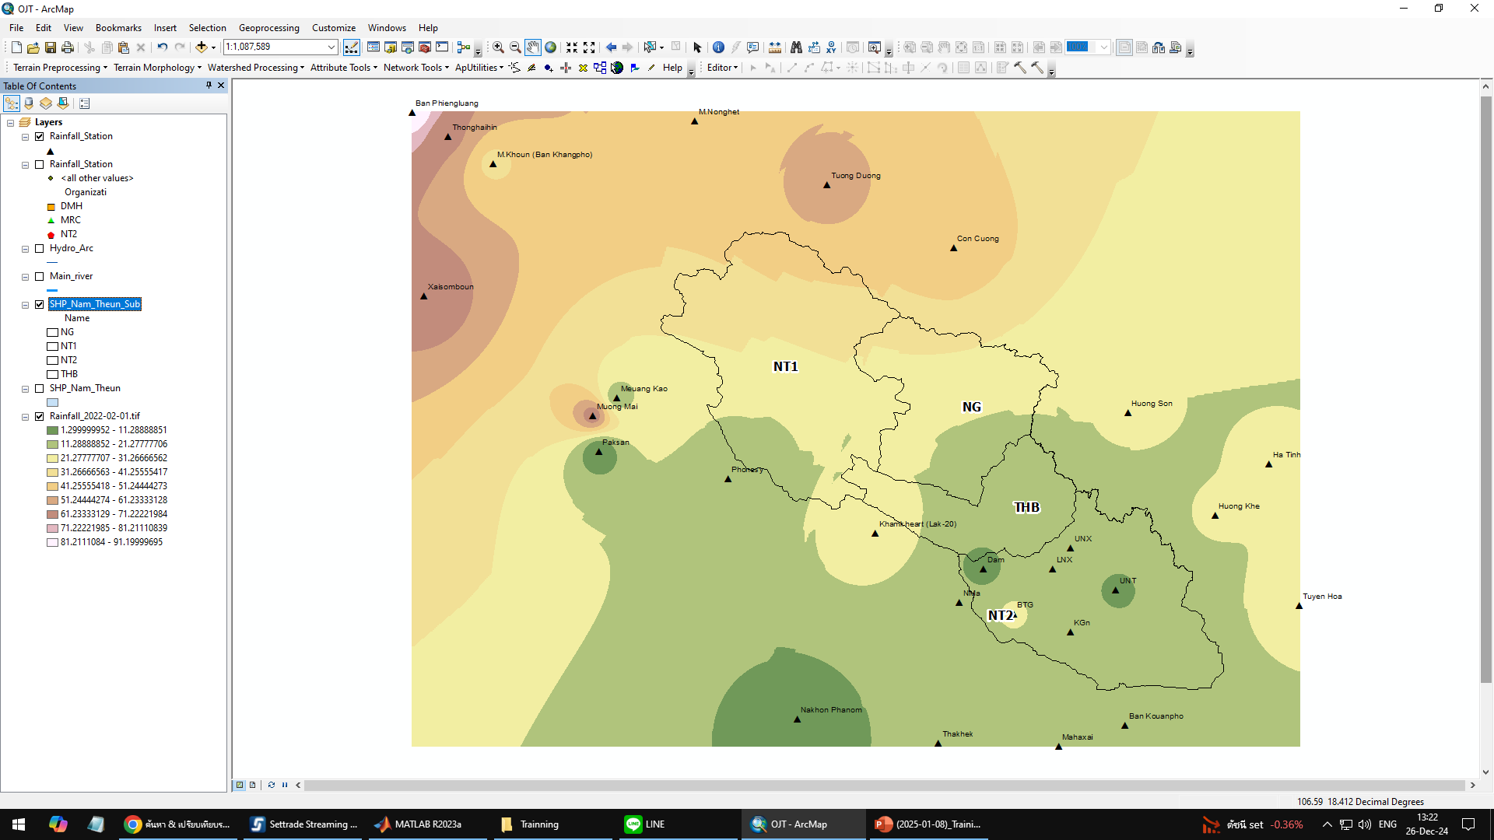
Preparing Gridded Gauged Rainfall (GGR) Using IDS
Step 2: Creating GGR using Inverse Distance Square (IDS)

Slide 39
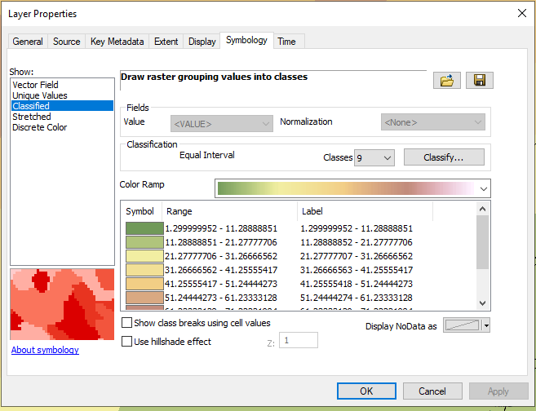
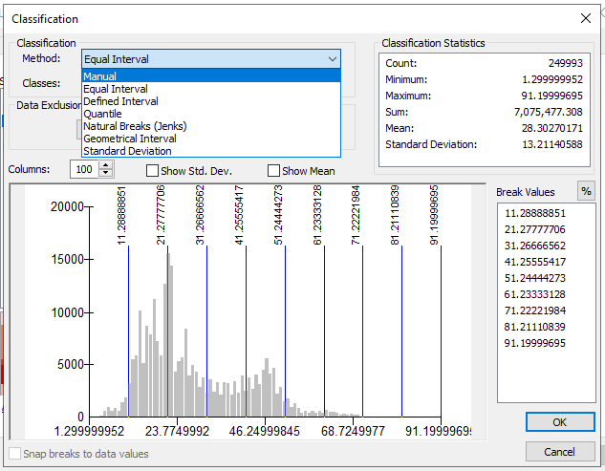
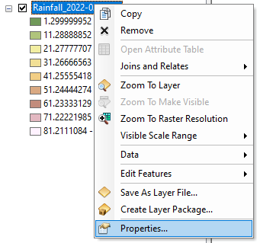
Preparing Gridded Gauged Rainfall (GGR) Using IDS
Step 2: Creating GGR using Inverse Distance Square (IDS)
Layer properties: Symbology
3
2
4
1

Slide 40
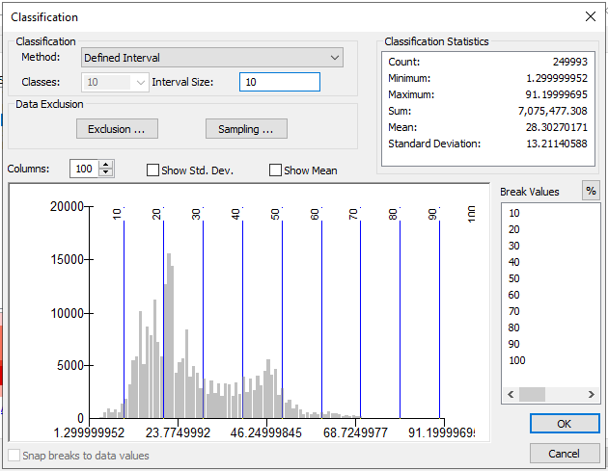
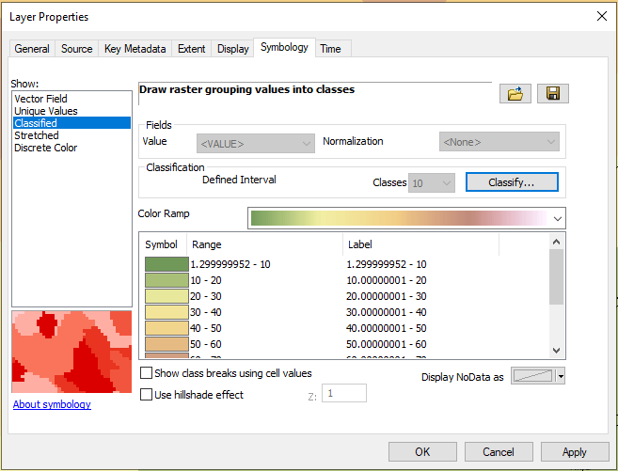
Preparing Gridded Gauged Rainfall (GGR) Using IDS
Step 2: Creating GGR using Inverse Distance Square (IDS)
Example for Classification by Defined Interval

Slide 41
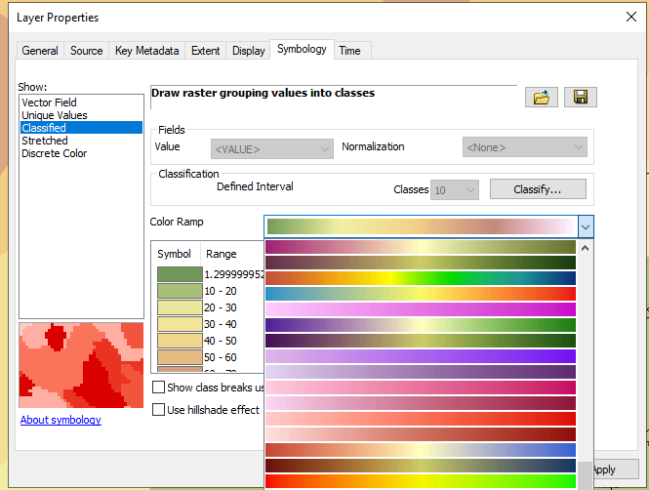
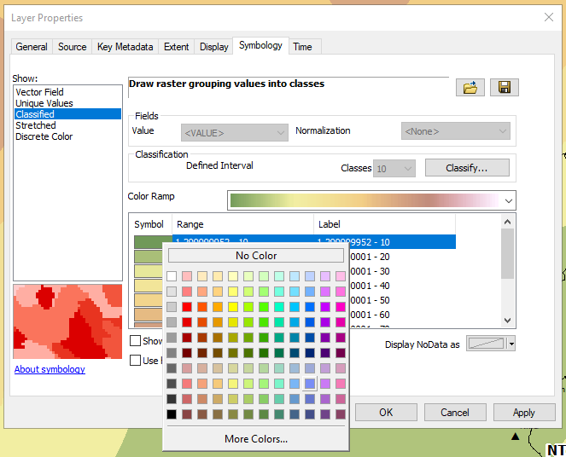
Preparing Gridded Gauged Rainfall (GGR) Using IDS
Step 2: Creating GGR using Inverse Distance Square (IDS)
How to change color?
Click here
Click here
Method 1
Method 2

Slide 42
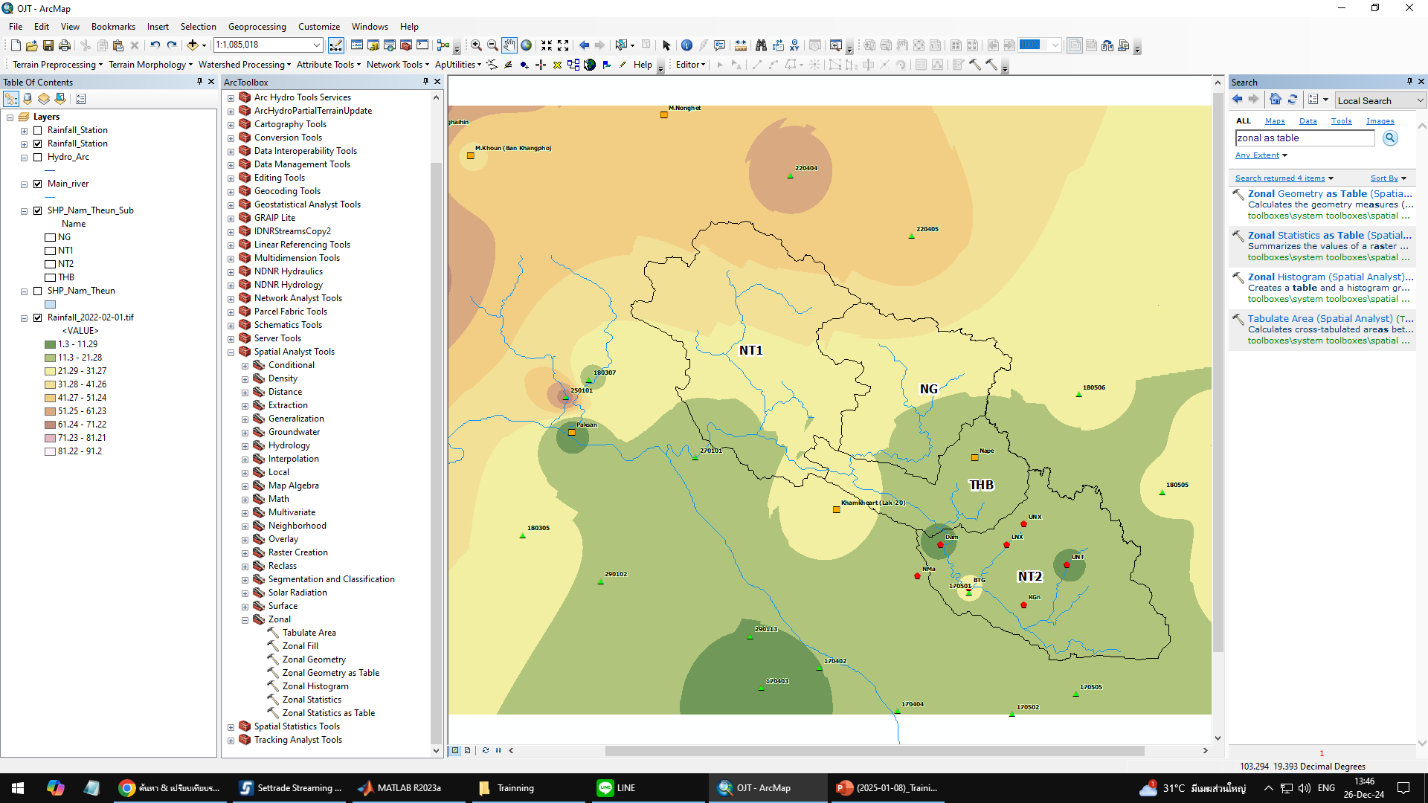
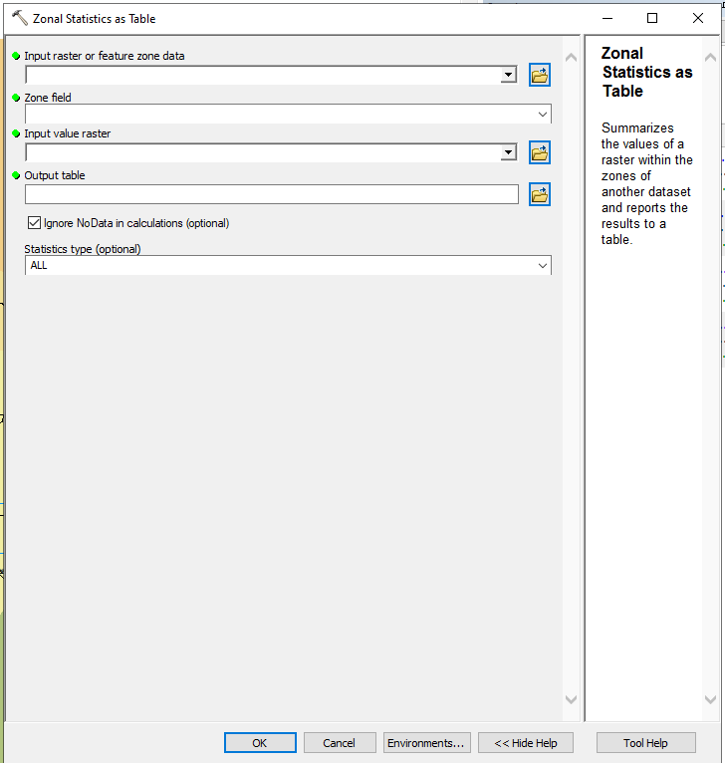
Zonal Rainfall Raster
Zonal GGR
Method 2
Method 1

Slide 43
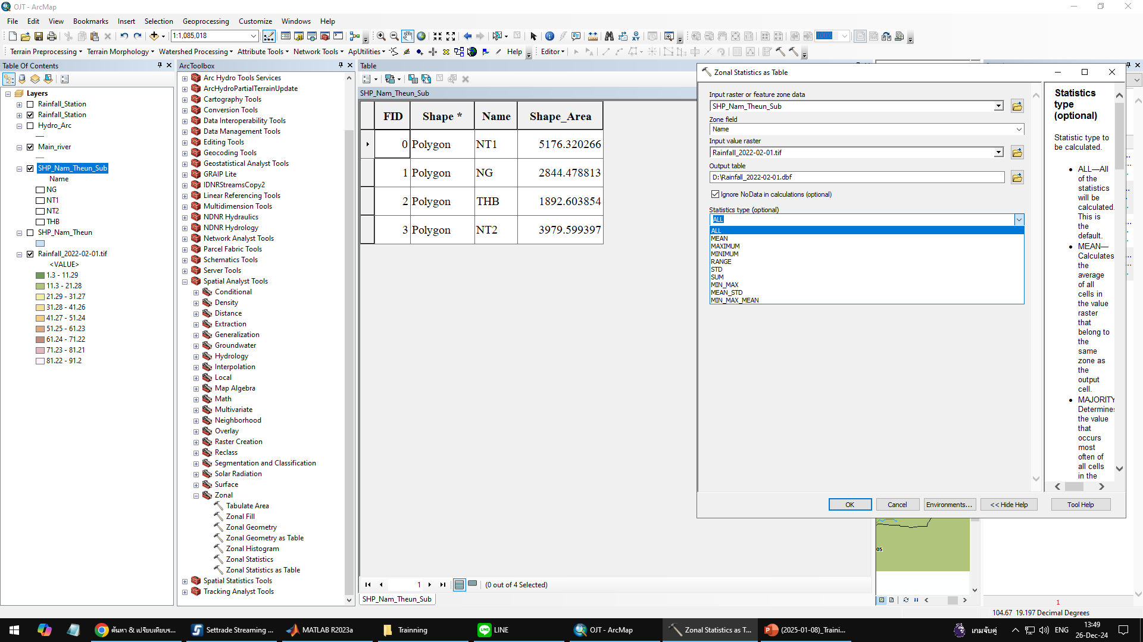
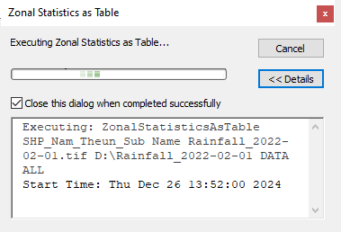
Zonal Rainfall Raster
1
2

Slide 44
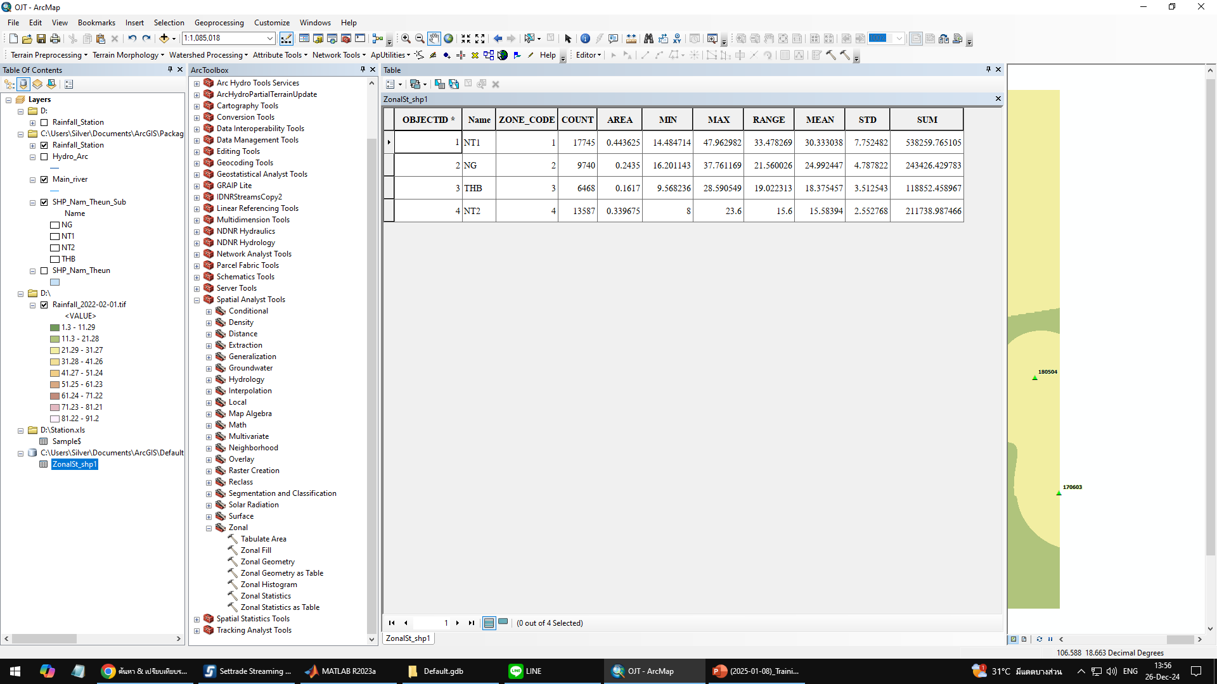
Zonal Rainfall Raster
Display value

Slide 45
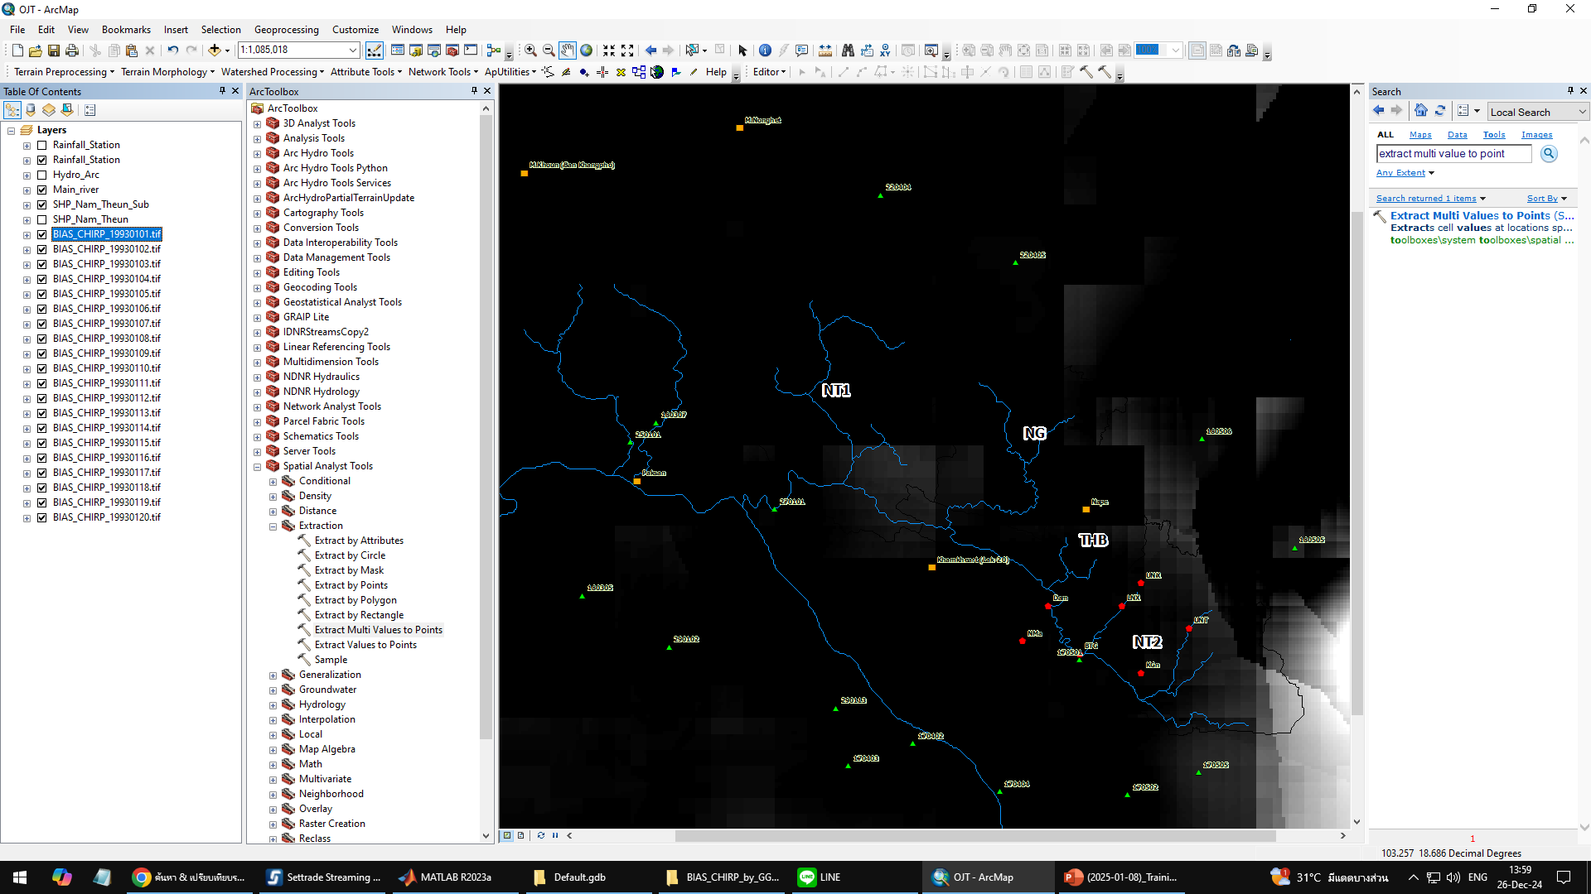
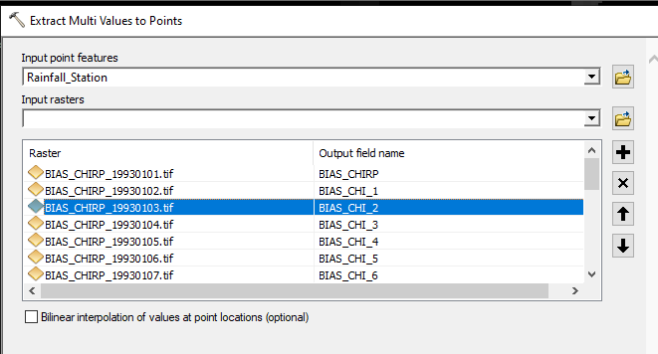
Zonal Rainfall Raster
Rainfall time series at 34 stations
Method 2
Add Raster
Method 1

Slide 46
Zonal Rainfall Raster
Rainfall time series at 34 stations
Before
After

Slide 47
Zonal Rainfall Raster
Zonal Rainfall Raster – Using python code (V2)
Python code for zonal statistic
Macro file for read time series data

Slide 48
Zonal Rainfall Raster
Zonal Rainfall Raster – Using python code (V2)
Folder for “.tif” file
(CHIRP_BC from project)
Folder for collect data from python

Slide 49
Zonal Rainfall Raster
Import module
Check spatial
Create environments
Processing
Define Date (Start - End)
Define boundary and file directory

Slide 50
Zonal Rainfall Raster
Click “Run” / “F5”

Slide 51
Zonal Rainfall Raster
Zonal Rainfall Raster – Using python code (V2)
1. Search “ *.dbf ”
Folder for collect data from python
2. Click “Name” for sorting

Slide 52
Zonal Rainfall Raster
Example output file

Slide 53
Zonal Rainfall Raster
Zonal Rainfall Raster – Using python code (V2)
1. Ctrl + A (select all)
2. Shift + Right click
3. Click “Copy as path”

Slide 54
Zonal Rainfall Raster
Macro file
Define parameter from
from slide 52
Station Start = ………..
Run Start = ………..
Round = ………
Station Stop = ……….
Run Stop = ……….

Slide 55
Zonal Rainfall Raster
Macro file
From slide 53
(Paste path of file)

Slide 56
Zonal Rainfall Raster
Macro file

Slide 57
Zonal Rainfall Raster
Time series data
Sheet: Result

